Slide 1
WELCOME TO IMPOSSIBLE

Slide 2
Kaun Banega CommandPati?

Slide 3
Slide 1
TIME LIMIT:
15 seconds
START TIMER
TIME’S UP!
Question :
What is the expansion of Sudo in Linux command?

Slide 4
Answer: "super user do"
sudo (/ˈsuːduː/ or /ˈsuːdoʊ/) is a program for Unix-like computer operating systems that allows users to run programs with the security privileges of another user, by default the superuser. It originally stood for "superuser do" as the older versions of sudo were designed to run commands only as the superuser.

Slide 5
Slide 1
TIME LIMIT:
60 seconds
START TIMER
TIME’S UP!
Question: Match the following
0: a) No permission
1: b)Execute permission
2: c)Read permission
3: d)Write and execute permissions
4: e)Write permission
5: f)Read and write permissions.
6: g)Read, write and execute permissions.
7: h)Read and execute permissions

Slide 6
Answer:
0: a) No permission
1: b) Execute permission
2: e) Write permission
3: d) Write and execute permissions
4: c) Read permission
5: h) Read and execute permissions
6: f) Read and write permissions
7: g) Read, write and execute permissions

Slide 7
Slide 1
TIME LIMIT:
30 seconds
START TIMER
TIME’S UP!
Question:
The finger command gives you :
A short finger information about the user.
Suggest user that -”Hey!!! @user, your fingers are short”.
C) A short dump of information about a user, including the time of the user’s last login, the user’s home directory, and the user account’s full name.
D) Information on how to change the proxy settings of the network.

Slide 8
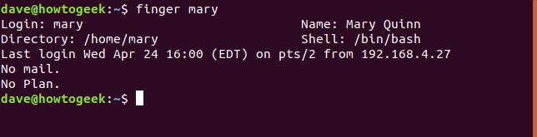
Answer : C) A short dump of information about a user, including the time of the user’s last login, the user’s home directory, and the user account’s full name.

Slide 9
Slide 1
TIME LIMIT:
30 seconds
START TIMER
TIME’S UP!
Question : What does nslookup do:
1)It search for the non-static packets in the network.
2)It gives back the IP address of particular domain.
3)It returns the static variable of the system variables.
4)It return the non-static TLD.

Slide 10
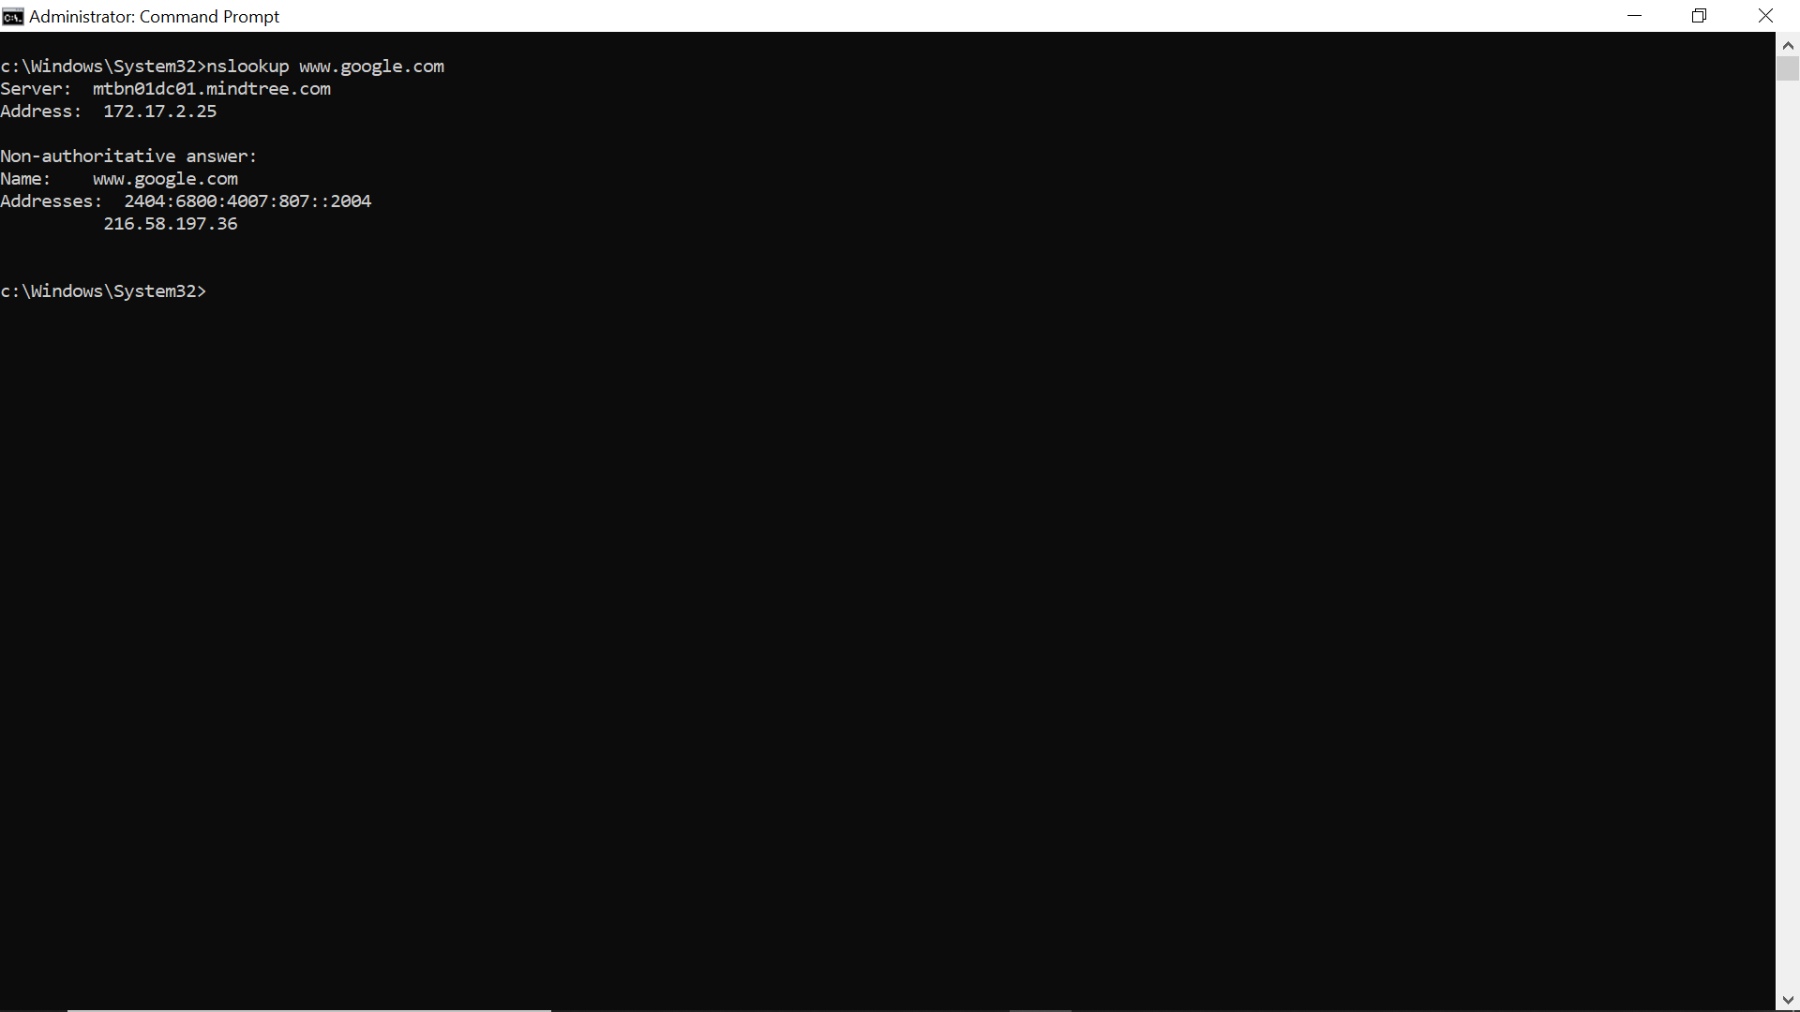
Answer: It gives back the IP address of particular domain.
Description:

Slide 11
Slide 1
TIME LIMIT:
30 seconds
START TIMER
TIME’S UP!
Question : Which of the commands uses sonar type of approach :
1)nslookup
2) Sonarconfig
3)ping
4) certutil

Slide 12
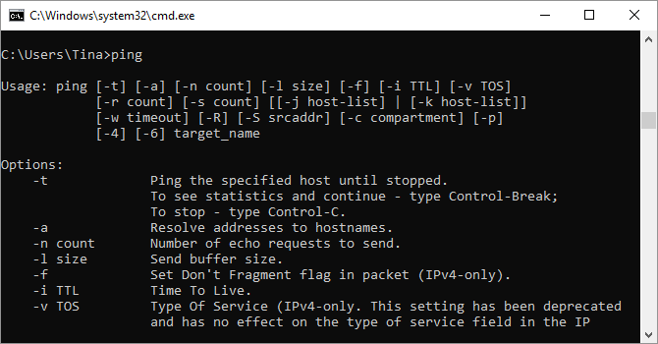
Answer: 1)Send a series of test packets to the specified address.
Sometimes, you need to know whether or not packets are making it to a specific networked device. That’s where ping comes in handy.
Typing “ping” followed by an IP address or web domain will send a series of test packets to the specified address. If they arrive and are returned, you know the device is capable of communicating with your PC; if it fails, you know that there’s something blocking communication between the device and your computer. This can help you decide if the root of the issue is an improper configuration or a failure of network hardware.

Slide 13
Slide 1
TIME LIMIT:
30 seconds
START TIMER
TIME’S UP!
Question :NETSTAT :
1)Will end the QUIZ.
2)Will get you a list of network settings.
3)Will get you a list of all active TCP connections from your computer.
4) Will get you a list of Net Settings

Slide 14
Answer:3)Will get you a list of all active TCP connections from your computer.
Concerned that you could have malware running on your computer that’s connecting to internet locations without you knowing about it?
If you run a NETSTAT command in the command prompt, you can get a list of all active TCP connections from your computer.

Slide 15
THANK YOU.

